Slide 1
Network Programming
K Hari Babu
Department of Computer Science & Information Systems

Slide 2
Outline

Slide 3
Outline
Name conversion
getaddrinfo()
getnameinfo()
gethostbyname()
Advanced I/O
recv(), send()
readv(), writev()
recvmsg(), sendmsg()
Framing & Encoding
HTTP

Slide 4
Name and Address Conversions (T1: ch11)

Slide 5
DNS
Two functions which we use to convert a domain name to IP address:
gethostbyname() - obsolete
getaddrinfo() - supports both IPv6 and IPv4
The DNS is used primarily to map between hostnames and IP addresses.
A hostname can be either a simple name, such as solaris or freebsd, or a fully qualified domain name (FQDN), such as solaris.unpbook.com.
Before DNS, mappings between hostnames and IP addresses were defined in a manually maintained local file, /etc/hosts

Slide 6
DNS
The /etc/hosts scheme scales poorly.
DNS was devised to address this problem.
Hostnames are organized into a hierarchical namespace.
Node in the DNS hierarchy has a label (name), which may be up to 63 characters.
At the root of the hierarchy is an unnamed node, the “anonymous root.”
A node’s domain name consists of all of the names from that node up to the root concatenated together, with each name separated by a period ( . )
No single organization or system manages the entire hierarchy.
Instead, there is a hierarchy of DNS servers, each of which manages a branch (a zone) of the tree.
For adding a host, admin has to add it to local name server.
DNS servers employ caching techniques to avoid unnecessary communication for frequently queried domain names.

Slide 7
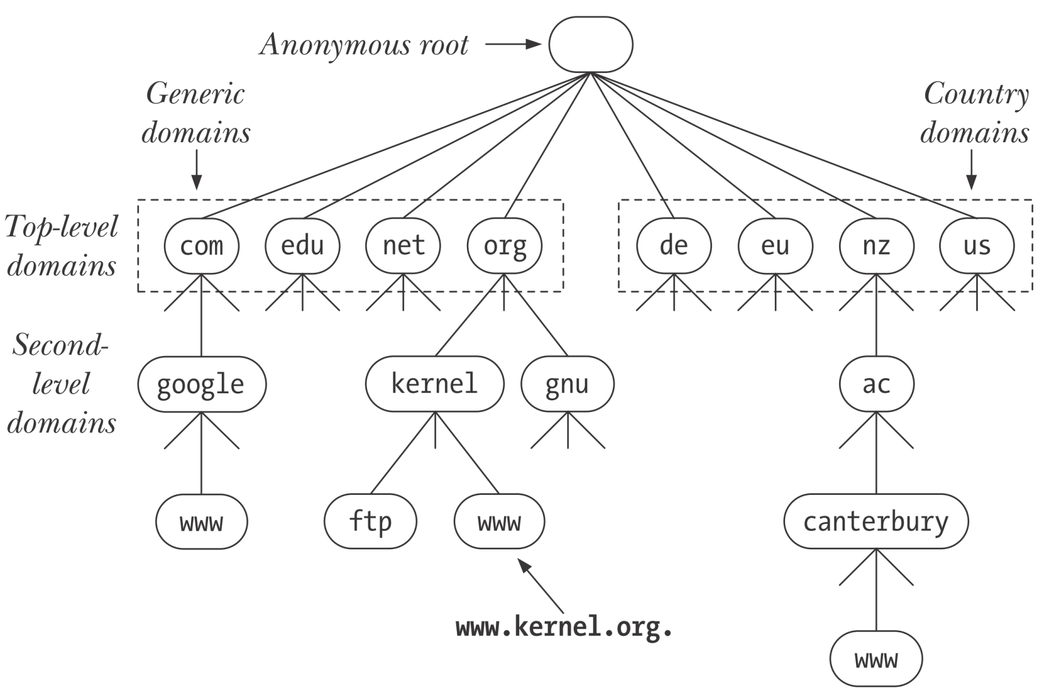
DNS

Slide 8
DNS Lookup
Not every name server knows about every other name server.
Name server must know the IP address of root servers.
Root servers know the name and location for all second-level domains.

Slide 9
Recursive and Iterative Lookups
DNS resolution requests fall into two categories: recursive and iterative.
In a recursive request, the requester asks the server to handle the entire task of resolution.
When an application on the local host calls getaddrinfo(), that function makes a recursive request to the local DNS server.
If the local DNS server does not itself have the information to perform the resolution, it resolves the domain name iteratively.

Slide 10
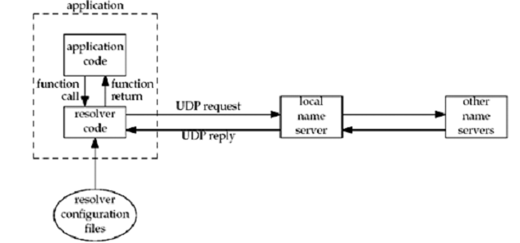
Resolvers and Name Servers
Resolver is part of the application

Slide 11
The /etc/services File
Well-known port numbers are centrally registered by IANA.
Each of these ports has a corresponding service name.
Because service numbers are centrally managed and are less volatile than IP addresses, an equivalent of the DNS server is usually not necessary. Instead, the port numbers and service names are recorded in the file /etc/services .
The getaddrinfo() and getnameinfo() functions use the information in this file to convert service names to port numbers and vice versa.

Slide 12
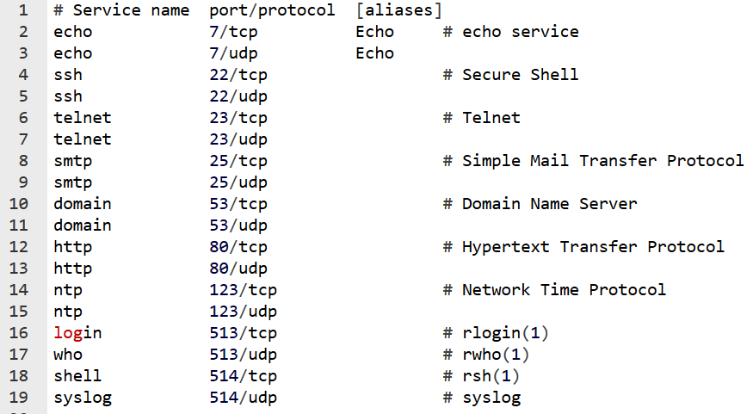
The /etc/services File

Slide 13
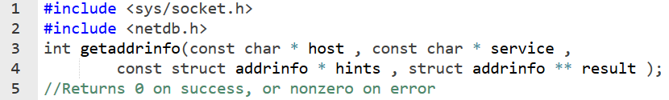
Host and Service Conversion
The getaddrinfo() function converts host and service names to IP addresses and port numbers.
successor to the obsolete gethostbyname() and getservbyname() functions
Given a host name and a service name, getaddrinfo() returns a list of socket address structures, each of which contains an IP address and port number.

Slide 14
The getaddrinfo() Function
As input, getaddrinfo() takes the arguments host, service, and hints.
Host:
It can be hostname or numeric address string 172.24.2.19
Service:
This contains either service name or port number.
Hints:
The hints argument points to an addrinfo structure that specifies further criteria for selecting the socket address structures returned via result.

Slide 15
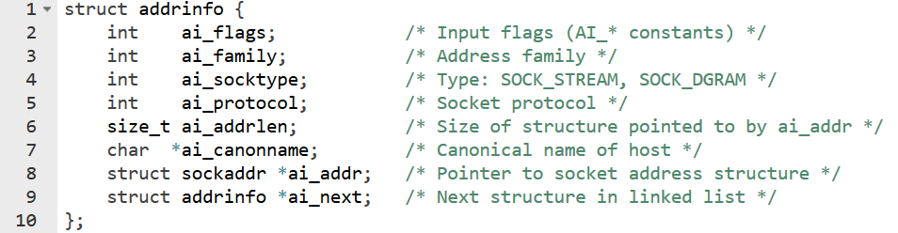
Addrinfo structure
As output, getaddrinfo() dynamically allocates a linked list of addrinfo structures and sets result pointing to the beginning of this list.
Each of these addrinfo structures includes a pointer to a socket address structure corresponding to host and service.

Slide 16
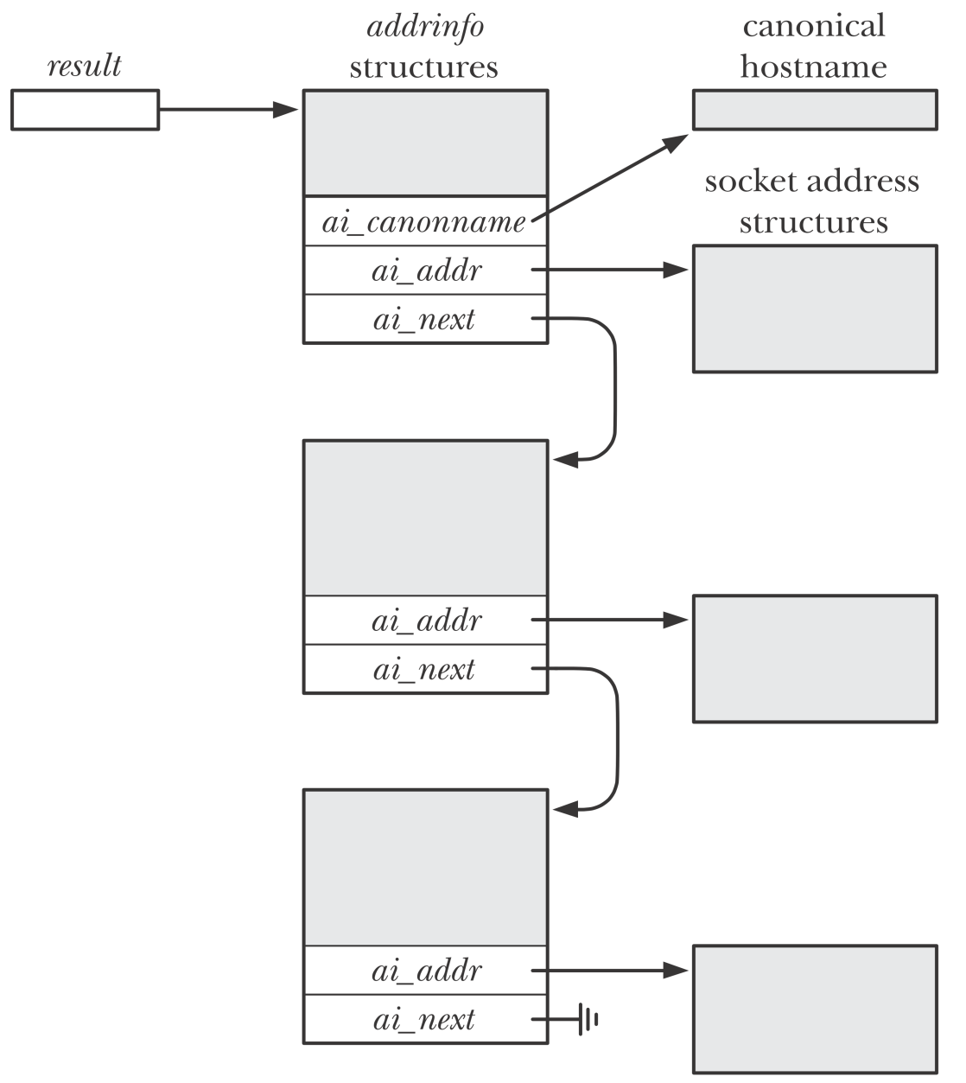
Result

Slide 17
The hints Argument
Hints is either a null pointer or a pointer to an addrinfo structure.
the caller fills in this structure with hints about the types of information the caller wants returned.
The members of the hints structure that can be set by the caller are:
ai_flags (zero or more AI_XXX values OR'ed together)
ai_family (an AF_xxx value)
ai_socktype (a SOCK_xxx value)
ai_protocol
For example,
if the specified service is provided for both TCP and UDP, set ai_socktype member of the hints structure to SOCK_DGRAM. Then only information returned will be for datagram sockets.

Slide 18
The hints Argument
AI_PASSIVE
Returnsocket address structures suitable for a passive open.
If host is null, then IP will be INADDR_ANY or IN6ADDR_ANY_INIT.
AI_CANONNAME
Tells the function to return the canonical name of the host.
AI_NUMERICHOST
the hostname argument must be a numeric address string.
Prevents name resolution.
AI_NUMERICSERV
the service argument must be a decimal port number string.
Prevents any kind of name-to-service resolution;
AI_V4MAPPED
If specified along with an ai_family of AF_INET6, then returns IPv4-mapped IPv6 addresses corresponding to A records if there are no available AAAA records.

Slide 19
The hints Argument
Returns linked list of addrinfo structures, linked through the ai_next pointer.
There are two ways that multiple structures can be returned:
Multiple ips per hostname; one sockaddr structure for each ip
Service is provided for multiple socket types; SOCK_STREAM or SOCK_DGRAM
For example, if no hints are provided and if the domain service is looked up for a host with two IP addresses, four addrinfo structures are returned:
One for the first IP address and a socket type of SOCK_STREAM
One for the first IP address and a socket type of SOCK_DGRAM
One for the second IP address and a socket type of SOCK_STREAM
One for the second IP address and a socket type of SOCK_DGRAM

Slide 20
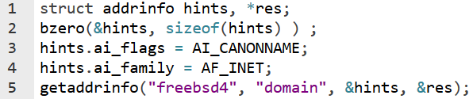
Example
Consider the following code

Slide 21
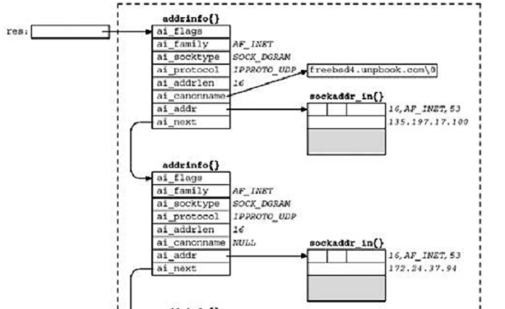
Result
Base pointer
to linked list

Slide 22
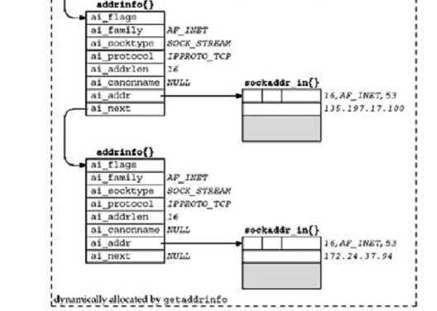
Result

Slide 23
Usage
Sockaddr structure in addrinfo structures is ready for
a call to socket
then either a call to connect or sendto (for a client), or bind (for a server).
The arguments to socket are the members ai_family, ai_socktype, and ai_protocol.
The second and third arguments to either connect or bind are ai_addr, and ai_addrlen

Slide 24
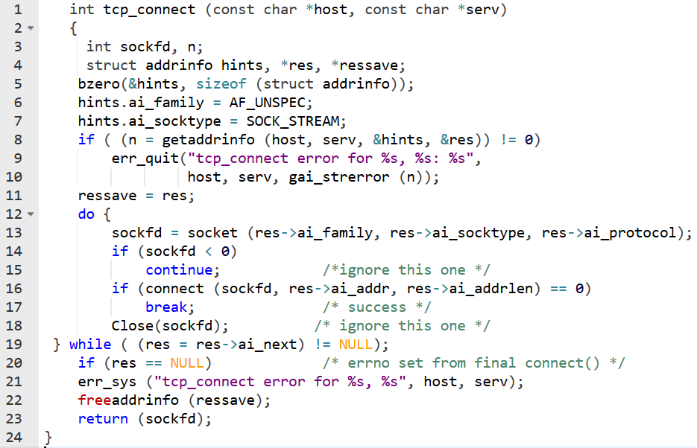
On client side

Slide 25
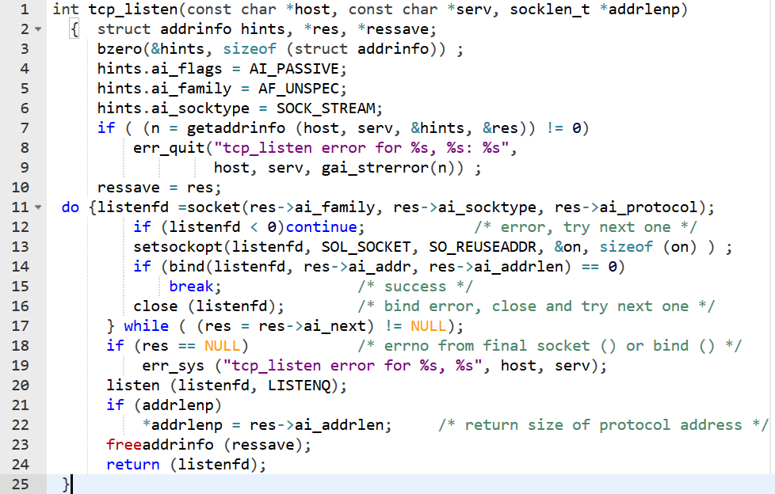
Server side usage

Slide 26


Freeing addrinfo Lists
The getaddrinfo() function dynamically allocates memory for all of the structures referred to by result.
Diagnosing errors
Errors returned by getaddrinfo() are not stored in errno.
They have to be looked up using

Slide 27
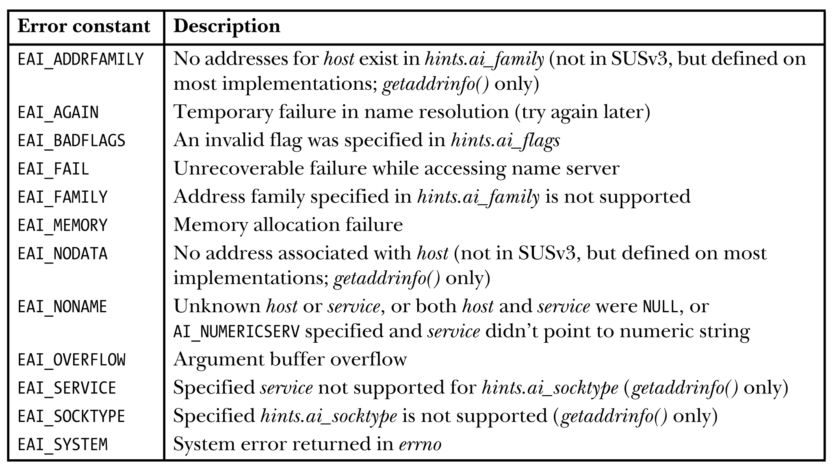
Error Codes

Slide 28
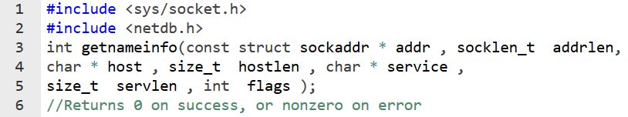
getnameinfo()
This function is the converse of getaddrinfo(). Takes socket address structure and returns host, and service.
NI_DGRAM
Default is stream socket service. This make datagram service.
NI_NAMEREQD
Default: if no name found, return numeric ip and port. If this is on, error is returned.

Slide 29
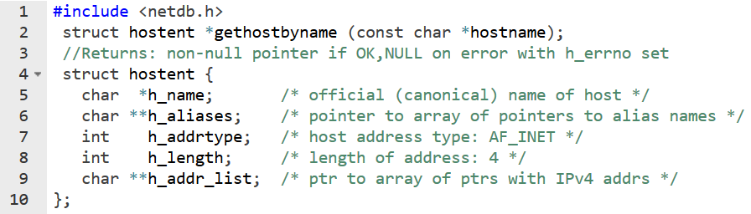
gethostbyname()
Returns only A type (IPv4) records
can return multiple IP addresses pointed by h_addr_list.

Slide 30
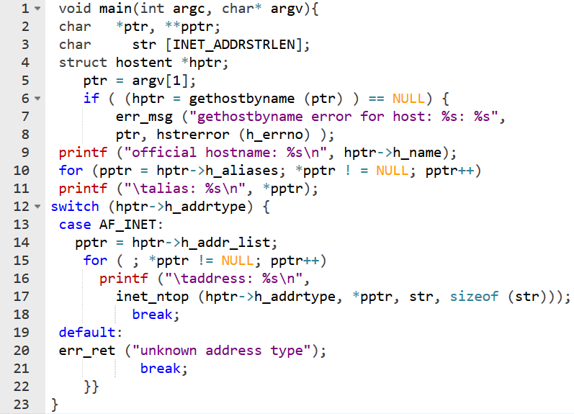
gethostbyname() example

Slide 31
Advanced I/O Functions (T1: ch 14)

Slide 32
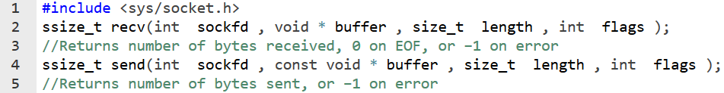
recv() and send()
The recv() and send() system calls perform I/O on connected sockets (TCP or connected UDP sockets).
Socket-Specific I/O System Calls:
They provide socket-specific functionality not available with read(0 and write().
Same as read() and write() except for flags.
Return values are same as read() and write().

Slide 33
recv() flags
MSG_DONTWAIT:
perform a non-blocking recv().
can be done using fcntl() call but that will make sock fd non-blocking. Here only this operation is non-blocking.
MSG_OOB:
receive out-of-band data on the socket.
MSG_PEEK:
retrieve a copy of the requested bytes from the socket buffer.
Data is not removed from the socket buffer.
Used for knowing the no of bytes available on the buffer.
MSG_WAITALL
Blocks until length bytes are read from socket buffer.
May get interrupted by signals.

Slide 34
send() flags
MSG_DONTWAIT
Perform a non-blocking send.
MSG_MORE
Data written using send() or sendto() calls with this flag is packaged into a single datagram until a send() without this flag.
MSG_NOSIGNAL
Do not generate SIGPIPE signal. Return only EPIPE error.
MSG_OOB
Write out of band data on TCP.

Slide 35
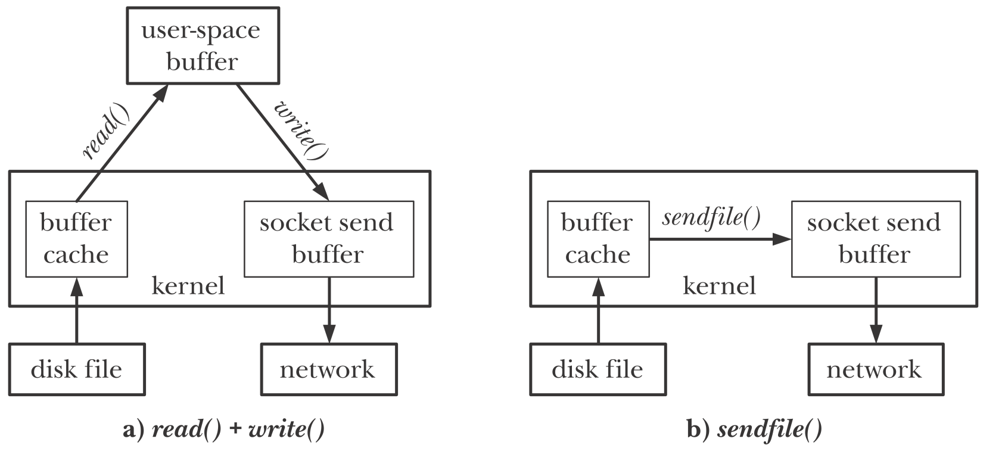
sendfile() sys call (R1: 61.4)
Transferring large file in web servers requires repeated calls to read() and write().
This is inefficient.

Slide 36
sendfile() sys call (R1: 61.4)
The sendfile() sys call is designed to eliminate copying file data into user space.
File contents are directly transferred to the socket without going through user space.
This is referred as a zero-copy transfer.
out_fd: is the socket fd.
In_fd: is regular file fd.
off_t: is the offset. This is a value-result argument.
count is the number of bytes to be transferred.
sendfile doesn’t change the file offset for in_fd.

Slide 37
TCP_CORK socket option
When a file is requested, web server would first send the HTTP headers and followed by the file contents.
Normally this will result in 2 TCP segments.
Leads to inefficient use of network bandwidth.
TCP_CORK option if enabled buffers data in TCP until either
upper limit on the size of a segment is reached,
the TCP_CORK option is disabled,
the socket is closed, or
a maximum of 200 milliseconds passes from the time that the first corked byte is written.
This can be achieved by putting both into single buffer or using writev(). But these can’t be used with sendfile().

Slide 38
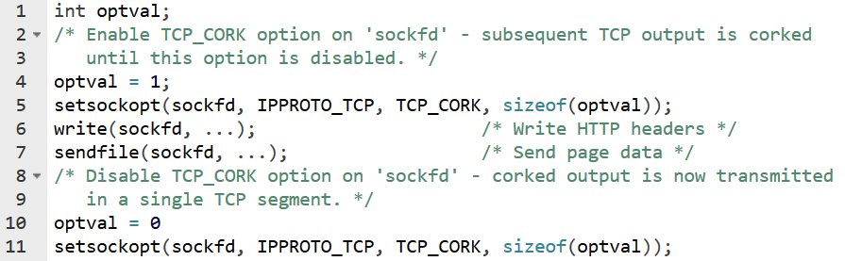
TCP_CORK
There is also UDP_CORK option that buffers multiple data outputs into a single datagram.

Slide 39
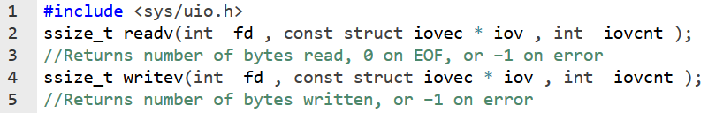
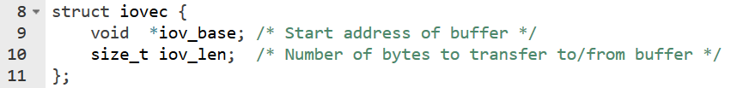
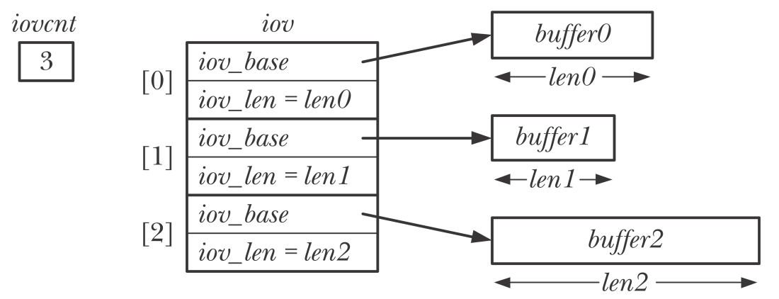
readv() and writev()
The readv() and writev() system calls perform scatter-gather I/O.
iov points to an array of buffers, each in iovec structure.

Slide 40
readv() and writev()
The readv() system call performs scatter input:
Reads from the file and puts the data into the buffer starting at iov[0]. Once the first buffer is full, it goes to another.
readv() completes atomically:
Kernel performs a single data transfer.
Assured that all the bytes read are contiguous in the file. File offset can’t be changed by other process.
The writev() call performs gather output:
Starting from the first buffer, writes the data contiguously into the file.
Partial write is possible.
writev() completes atomically.
readv() and writev() are used for convenience and speed.
Reduce number of sys calls.

Slide 41
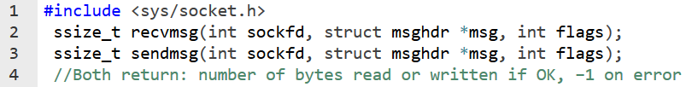
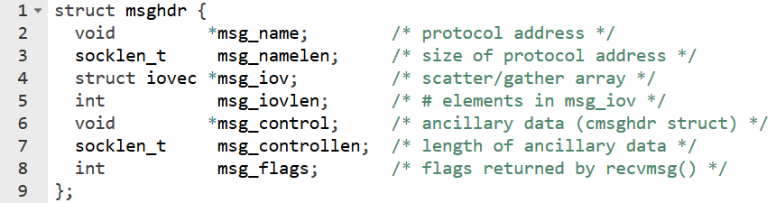
sendmsg() & recvmsg() sys calls
The sendmsg() and recvmsg() system calls are the most general purpose of the socket I/O system calls.
The sendmsg() system call can do everything that is done by write(), send(), and sendto();
the recvmsg() system call can do everything that is done by read(), recv(), and recvfrom().

Slide 42
sendmsg() & recvmsg() sys calls
Can be used to send or receive ancillary data (control information).
Flags are

Slide 43
Flags returned by rcvmsg()
MSG_BCAST
is returned if the datagram was received as as a broadcast.
MSG_MCAST
is returned if the datagram was received as a link-layer multicast.
MSG_TRUNC
is returned if the datagram was truncated
MSG_CTRUNC
is returned if the ancillary data was truncated
MSG_EOR
is turned on if the returned data ends a logical record.
MSG_OOB
This flag is never returned for TCP out-of-band data. This flag is returned by other protocol suites (e.g., the OSI protocols).
MSG_NOTIFICATON
This flag is returned for SCTP receivers to indicate that the message read is an event notification, not a data message.

Slide 44
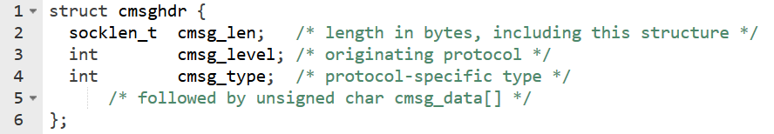
Ancillary Data
Ancillary data can be sent and received using the msg_control and msg_controllen members of the msghdr structure.
Another term for ancillary data is control information.

Slide 45
Ancillary Data
Ancillary data is domain specific.

Slide 46
Ancillary Data
File descriptors and process credentials can be passed between unrelated processes using ancillary data.

Slide 47
Framing, Encoding & Decoding

Slide 48
Encoding & Framing
Wire format: format of message in the network.
Application protocol specifies the wire format for the messages to be exchanged between sender and receiver.
Can be: binary or text represented.
Encoding:
Sender has to fill in the fields of the message ( bits or byes or multiple bytes) considering the network byte order.
Framing
How to identify boundaries between messages

Slide 49
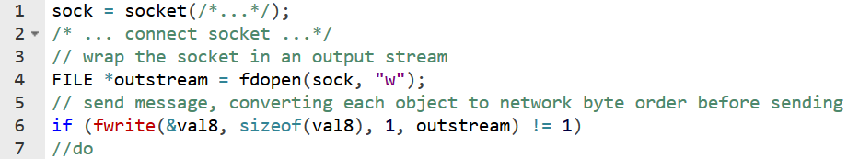
Wrapping TCP Sockets in Streams
Wrapping TCP Sockets in Streams
Using fdopen
fread() and fwrite() functions read/write a number of objects from/to the stream.
They return no of objects written or read.
FILE-streams can only be used with TCP sockets

Slide 50
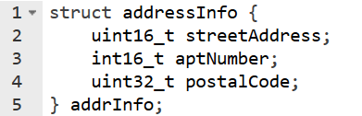
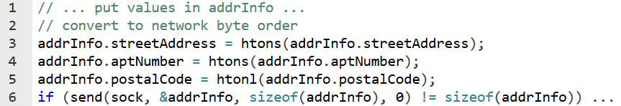
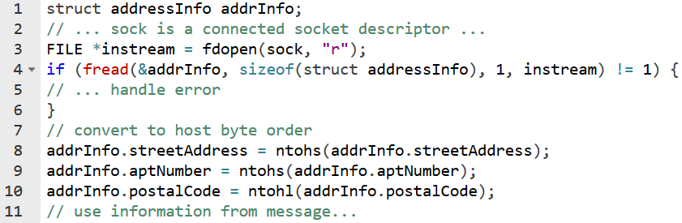
Wrapping TCP Sockets in Streams
If we have to exchange data

Slide 51
Wrapping TCP Sockets in Streams
Using recv() will not help because there is no guarantee that all the bytes of the message will be returned in a single call.
We can use MSG_WAITALL

Slide 52
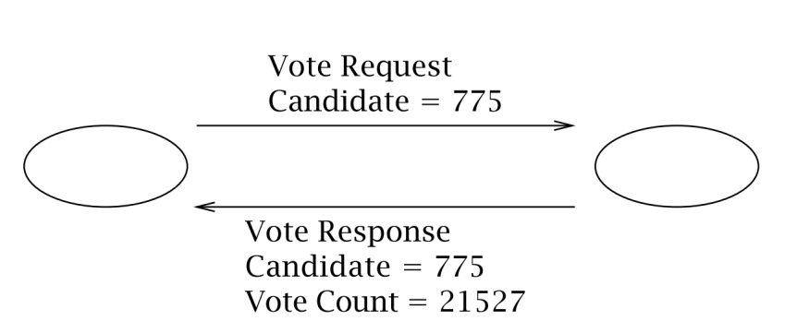
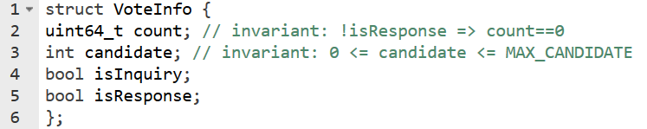
Case
Client sends a request message to the server:
inquiry request: how many votes are polled for a candidate.
Vote request: vote for a candidate.
For both the requests server responds with
Response flag
Candidate id
Vote count

Slide 53
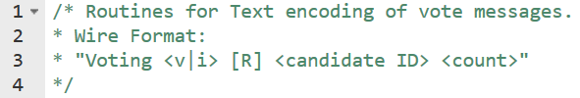
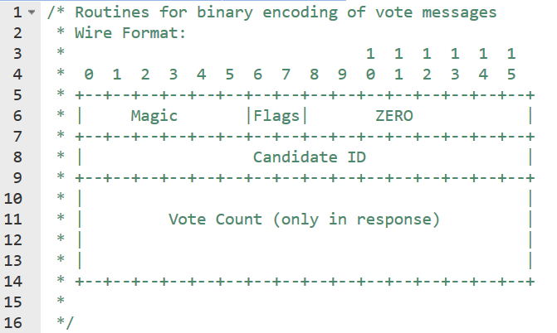
Encoding & decoding
Application uses VoteInfo structure for its internal bookkeeping.
Encoding: convert VoteInfo structure to wire format.
Decoding: convert back to VoteInfo structure

Slide 54
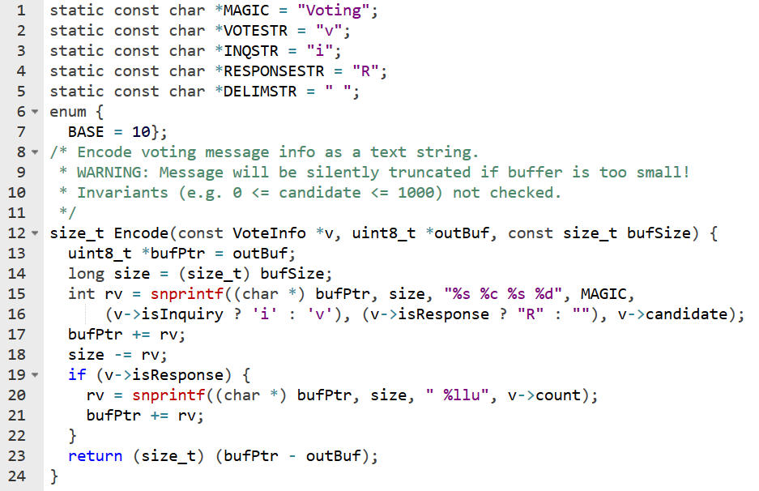
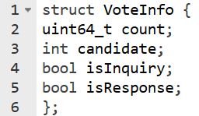
Encoding

Slide 55
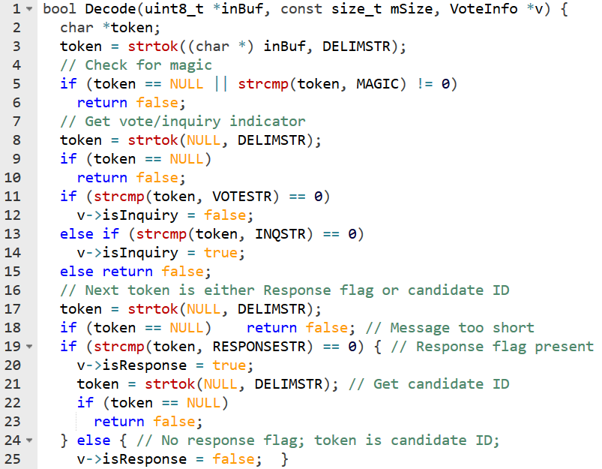
Decoding

Slide 56
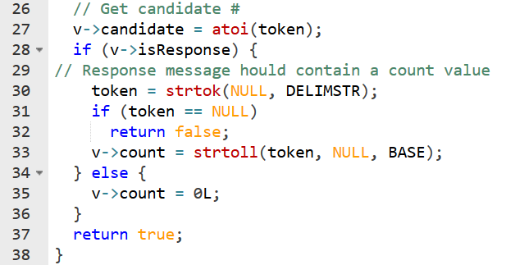
Decoding

Slide 57
Encoding a Binary Wire Format
Text based formats vary in length.
Binary formats always have fixed size.
Magic value 010101 helps in ensuring that we are receiving the right message.

Slide 58
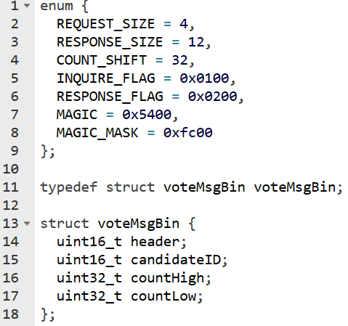
Encoding a Binary Wire Format
Generally declare an equivalent structure for the wire format.

Slide 59
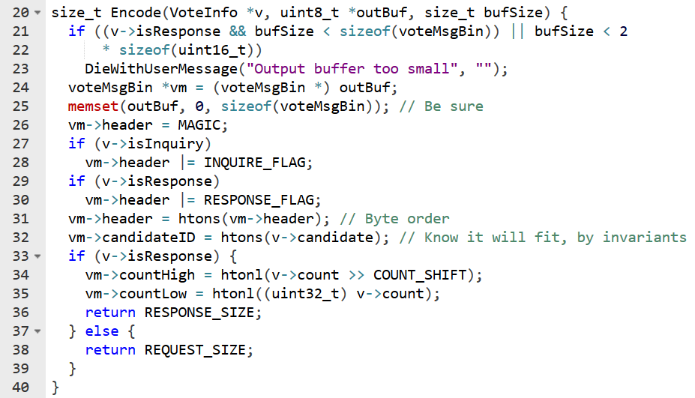
Encoding a Binary Wire Format

Slide 60
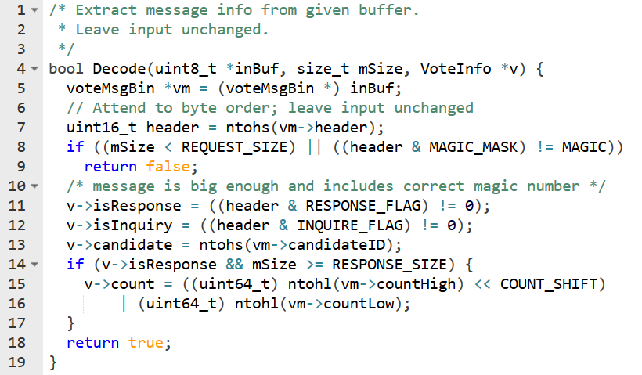
Decoding a Binary Wire Format

Slide 61
Framing
Framing refers to the general problem of enabling the receiver to locate the boundaries of a message.
the application protocol must specify how the receiver of a message can determine when it has received all of the message.
Whether information is encoded as text, as multibyte binary numbers, or as some combination of the two
This is trivial in UDP.
But TCP doesn’t preserve the boundaries.
If the message length is fixed, then we can wait until we read all of the bytes. But if the length is varying then?
Two techniques:
Delimiter based: The end of the message is indicated by a unique marker.
Explicit length: The variable-length ﬁeld or message is preceded by a length ﬁeld that tells how many bytes it contains.

Slide 62
Framing in HTTP

Slide 63
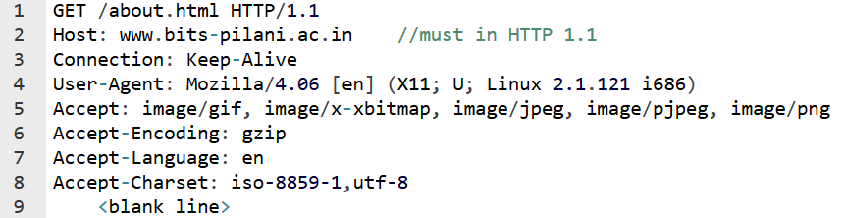
HTTP Request
HTTP is a request-response stateless protocol. HTTP/1.1 supports persistent connections.
HTTP Request:
GET request doesn’t include anything in the body.
Each line is terminated by \r\n.
Headers are terminated by an \n.
Framing: a blank line

Slide 64
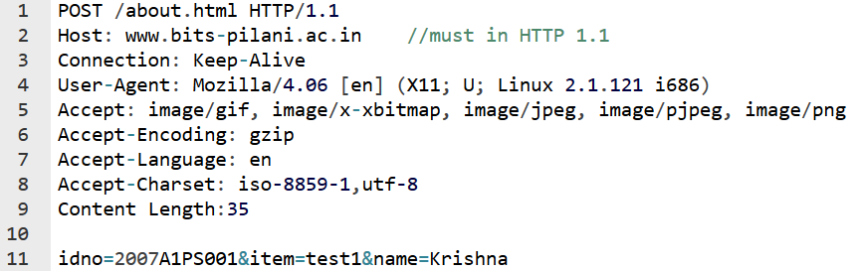
HTTP Request
POST request includes content in the body.
Length of the content is specified in the header.
Each line is terminated by \r\n.
Headers are terminated by an \n.
Framing: a blank line is end of headers.
Body’s boundary is identified by explicit-length method

Slide 65
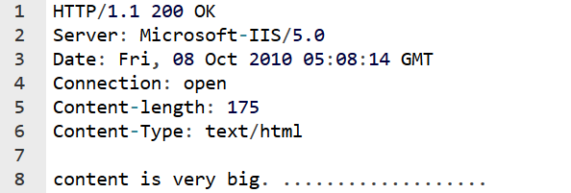
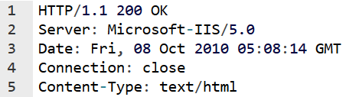
HTTP Response
Response header contains content-length field.
In dynamic output cases

Slide 66
CGI Programming
HTTP
SERVER
setenv(), dup(), fork(), exec(), ...
http request
CLIENT
CGI Program
http response

Slide 67
HTTP & Dynamic Outputs
It may not be convenient or even possible for a server to know the length of an item before sending.
Servers use the Common Gateway Interface (CGI) mechanism to create dynamic documents.
To provide for dynamic Web pages, the HTTP standard specifies that if the server does not know the length of an item a priori, the server can inform the browser that it will close the connection after transmitting the item

Slide 68
HTTP & Dynamic Outputs
Closing connection results in poor performance.
If server doesn’t know the output length a priori, it can also use chunked transfer encoding.
The sender breaks the message body into chunks of arbitrary length, and each chunk is sent with its length prepended;
It marks the end of the message with a zero-length chunk.
The sender uses the Transfer-Encoding: chunked header to signal the use of chunking.
This mechanism allows the sender to buffer small pieces of the message, instead of the entire message, without adding much complexity or overhead.

Slide 69
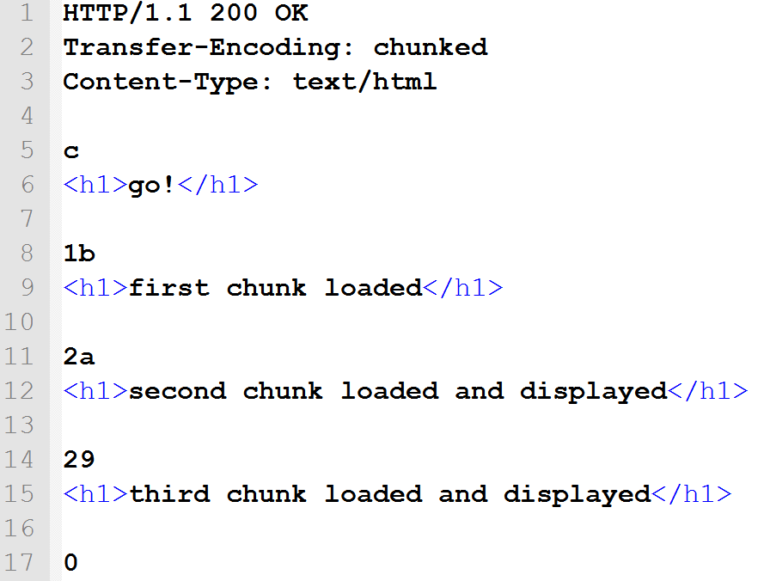
Transfer-Encoding: chunked

Slide 70
Acknowledgements

Slide 71
Q&A

Slide 72
Thank You

